Slide 1

Exploratory Data Analysis for Unicorn Companies and Investors
Insights and Recommendations

Slide 2

Findings
1. Data Quality and Transformation:
Proper data type for Valuation and Funding
01
No missing values
03
Industry analysis shows Fintech leading
04
Introduction of key metrics: Years to Unicorn, ROI, and Annual ROI
02

Slide 3
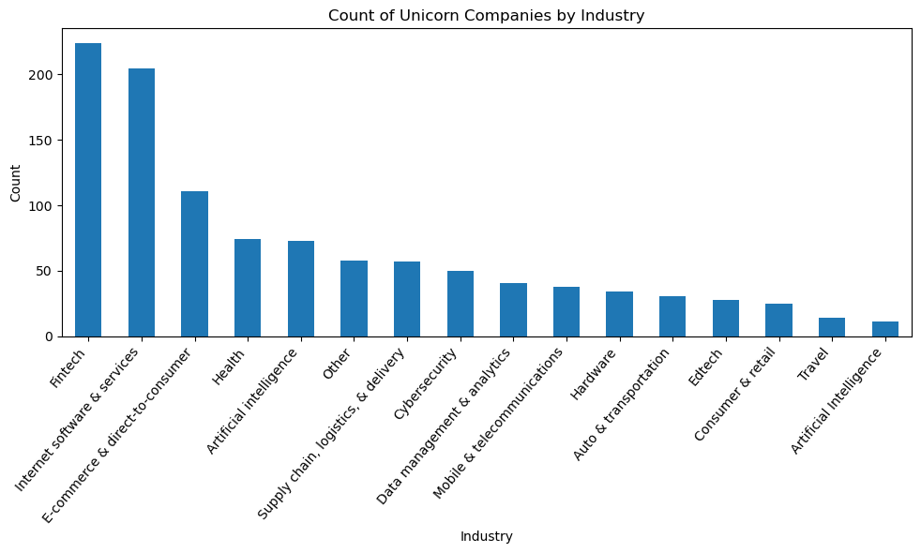
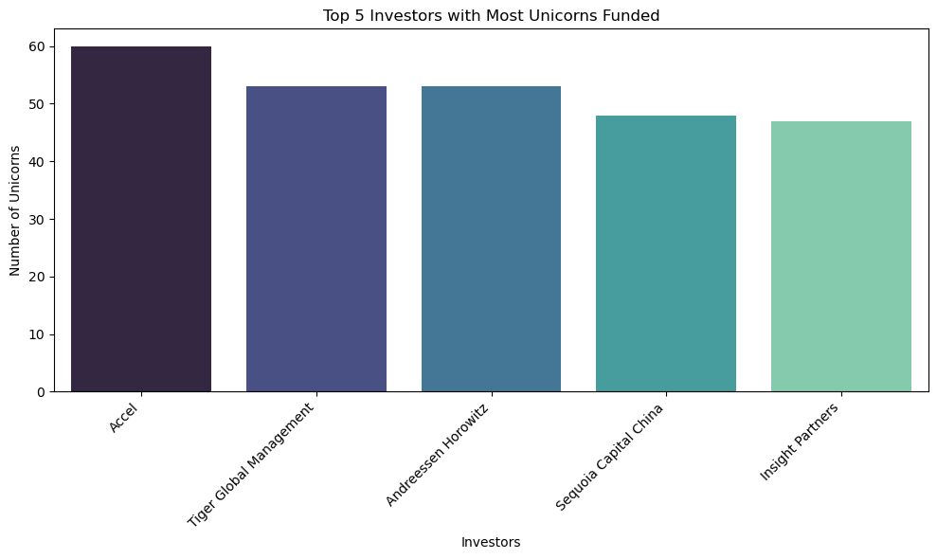
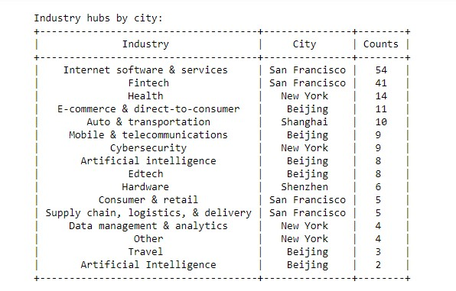
More Findings
2. Global Distribution:
United States leads with 562 Unicorn Companies
China, India, UK, and Germany follow
3. City Analysis: San Francisco is a prominent city
4. Top Investors: ACCEL, Tiger Global Management, Andreessen Horowitz, Sequoia Capital China, and Insight Partners are the top investors in terms of funding unicorn companies.
5. Industry Analysis: Fintech leads in the number of unicorn companies, while Artificial Intelligence lags behind. The top five industries with unicorn companies are Fintech, Internet Software & Services, E-commerce & Direct-to-Consumer, Health, and Artificial Intelligence.

Slide 4
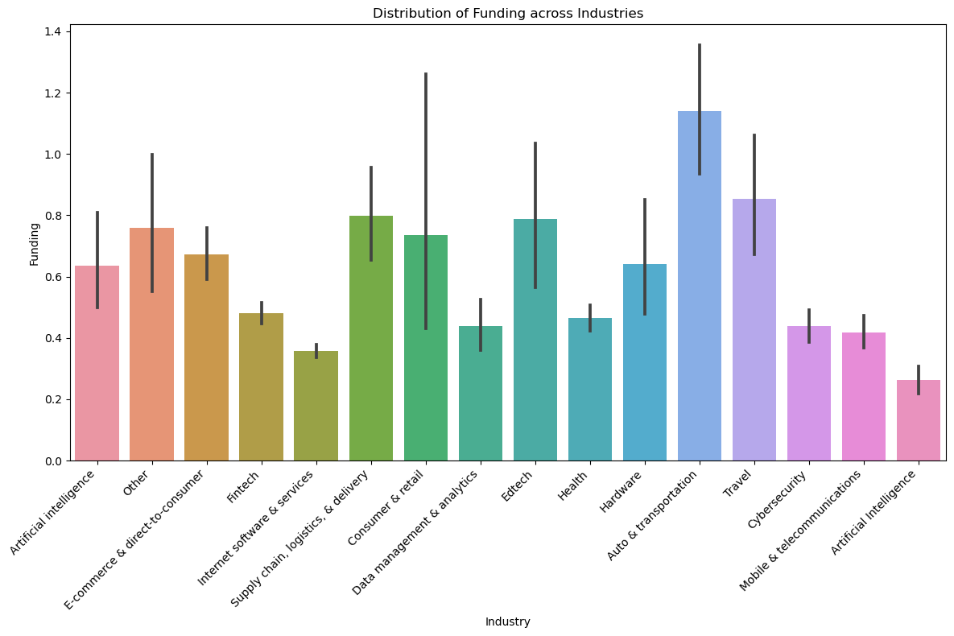
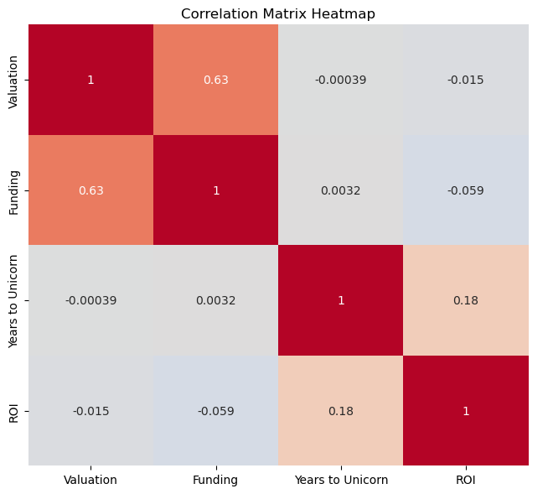
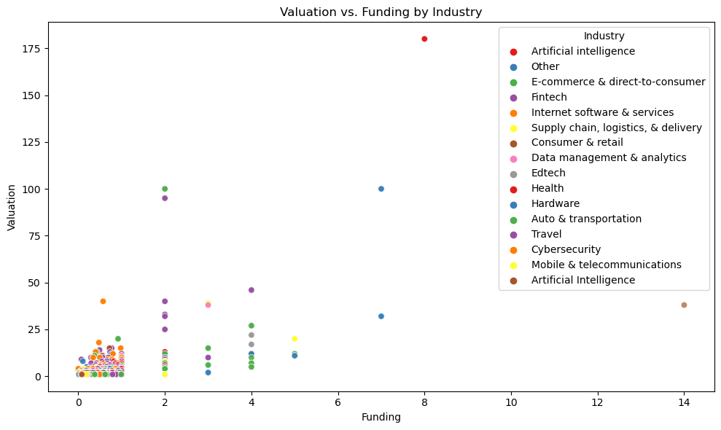
6. Valuation by Industry: Artificial Intelligence has the highest valuation relative to its funding.
7. Funding Distribution: Auto and Transportation, and Consumer Retail industries have received the most funding, while Internet Software Services have received the least.
8. Correlation: There's a positive correlation between funding received and valuation, but no correlation between the time it takes for a company to become a unicorn, funding received, and valuation.
More Findings

Slide 5

Conclusion and Recommendations
1. Invest in High Valuation Companies
Valuations above USD 10 billion
Average 6 years to attain unicorn status
2. Focus on Fintech and E-commerce
Strong average valuations
3. Explore San Francisco
Prominent city for unicorn companies
4. Investors can use these insights to make informed decisions in the unicorn company space.
5. Stay informed and continue monitoring the unicorn landscape for emerging trends and opportunities.

